Slide 1

Data Science 102
Data Analysis

Slide 2
Proposed Plan
 | Title | Description | Exercise
1 | Python 101 | Intro to syntax and core concepts | Python workbook
2 | Data Analysis | Analysis libraries (numpy and pandas) | CO2 Analysis
3 | Databases | DB storage and SQL | Build own database
4 | Visualisation | Sexy graphs, charts, and wordclouds | Colourful visualisation
5 | Machine Learning | Simple models | Regression & Decision Trees?
6 | Machine Learning | Complex models | Visual recognition
7 | Watson Integration | Integrating with Watson cloud services | Watson labs

Slide 3
Outline
Why Bother?
What to Learn
Manipulating Data

Slide 4

Why not just use Excel?
If it’s good enough for Test and Trace. It’s good enough for me
Versatile: clean and convert data
Powerful: handles large datasets
Extensible: combine with packages for visualisation and data scraping
Automation: I’m lazy as hell

Slide 5


What should I know?

Slide 6
Numbers x Python
Library (collection of software) used for maths in Python
Basic algebra and trigonometry
Advanced maths for multi-dimensional arrays and matrices

Slide 7
‘Panel data’ or ‘Python Data Analysis’
Library for data manipulation and analysis
Data structures, tables, and series
‘Excel in Python’

Slide 8
Let’s Get Doing

Slide 9
Appendices
Stuff I’ve stolen from elsewhere
If you want to go deeper into key methods within Pandas and Numpy

Slide 10
Introduction to Data Analysis

Slide 11
Outline
Data Science packages
NumPy Library
Pandas
- Series
- Dataframes
Manipulating Data in Pandas
Notes:
I am working between academy and industry
Teaching
Research
Projects
What is data science? It depends on you are talking with academia or industry.
For academy, it is mostly about ML, DM, Statistic and scientific computing and modeling
For industry, they don’t care about where you are coming, they have a problem, some data and need an answer, which is getting value out of data

Slide 12
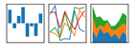


Python Packages for Data Science
Scientific Computing Libraries:
Pandas
(Data structures & Tools)
NumPy
(Arrays & Matrices)
SciPy
(Integrals, Solving Differential Equations, Optimization)
We are learning about these 2 today

Slide 13



Python Packages for Data Science
Algorithmic Libraries:
Scikit-Learn
(Machine Learning: Regression, Classification, Prediction, …)
TensorFlow
(Artificial / Deep Neural Networks)
StatsModels
(Explore Data, Estimate Statistical Models, and Perform Statistical Tests.)

Slide 14
NumPy

Slide 15

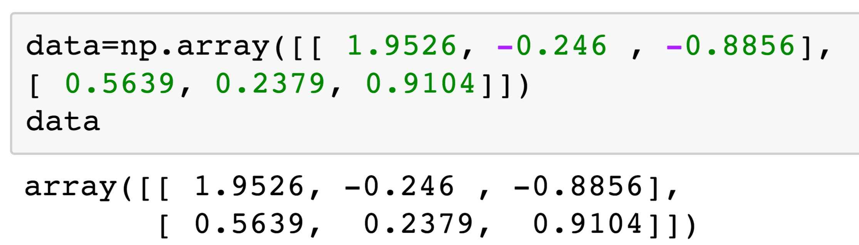
What is NumPy?
NumPy: NumPy is the fundamental package for scientific computing with Python
- Fast - Multidimensional Arrays - Vectorized Computation.

Slide 16
Indexing Arrays
Use a tuple to index multi-dimensional arrays
a[2,2]
Slicing arrays
a[2]
a[2,:]
a[1,2:]
a[:1,2:]
0 | 1 | 2
0
1
2

Slide 17
Pandas: Series and Dataframes

Slide 18
What is pandas?
pandas is an open-source library providing high performance data analysis tools in python.
Main data structures:
Series
Dataframes
With pandas:
- You can download data
- Visualize data
- Analyze data

Slide 19
pandas: Series
Series are a list of numbers, each element has data and an index
Default indexes are integers
Data | 11 | 12 | 13
Index | 0 | 1 | 2
s[1] = 12

Slide 20
pandas: Series (Cont’d)
data | 11 | 12 | 13
Index | a | b | c
s[ “a” ] = 11

Slide 21
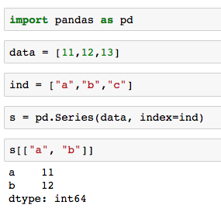
pandas: Series (Cont’d)
s[ “b” ] = 12
data | 11 | 12 | 13
Index | a | b | c
s[ “a” ] = 11

Slide 22
pandas: Dataframes
Two-dimensional tabular data structure with labeled axes (rows and columns).
columns
Dictionary | A | B | C
Index | Series 1 | Series 2 | Series 2
row

Slide 23
pandas: Dataframes (Cont’d)

Slide 24
pandas: Dataframes (Cont’d)
Can select columns:

Slide 25
pandas: Dataframes (Cont’d)
Read Data
We use pandas.read_csv() method to read csv file into pandas Dataframe.
pandas.read_csv(filepath, header=None)
header is an argument that allows you to set header of the dataset. Default
value is “infer”, meaning set the first row as header. None here means do not set
headers.
# import pandas library
import pandas as pd
# read the online file by the URL provides above, and assign it to variable "df"
df = pd.read_csv("https://archive.ics.uci.edu/ml/machine-learning-databases/autos/
imports-85.data", header=None)

Slide 26
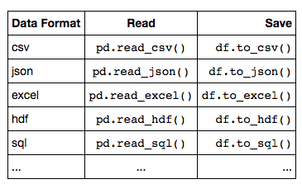
pandas: Dataframes (Cont’d)
Read/Save Other Data Formats
Same as read_csv() file, we use similar methods to read other data formats:

Slide 27
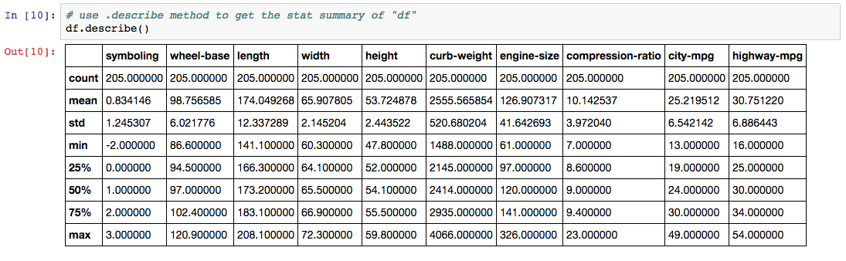
Basic Insights of Dataset – Describe()
Here it shows the statistical summary of all numeric-typed (int and float) columns.

Slide 28
Summary
Arrays store values in a table like structure with rows and columns, all the same type.
Pandas series – a row of values of the same type (e.g. int or string)
Padas Dataframe – a set of series in columns (similar to array but each column can be a different type e.g. string, int, float)
Each Dataframe column can can be indexed by its heading
Data files of many formats can be read into Dataframes

Slide 29

Exercises
Go through the “TMP107_W2_Data_Analysis_I-checkpoint.ipynb” Jupyter Notebook:
https://ibm.box.com/s/1yfodfx1c9v7yvd5nbobaqzilt60lezq
Make sure you understand the processes to data into Pandas DataFrames

Slide 30
Optional Kaggle Exercise

Slide 31

Diamond Prices
A dataset of >10k diamonds, their types and their price
Load “diamonds.csv” dataset into a Jupyter Notebook
https://ibm.box.com/s/8fq2kcmwcifl4kfma3ym4el5gerx0poe
Determine trends in the data
[Advanced] See if you can work out a model for diamond pricing
Details on the fields can be found: https://www.kaggle.com/shivam2503/diamonds
It also has Jupyter Notebooks from other people going through their answers (don’t look until you have attempted it!)

Slide 32
Pandas Dataframe Operations

Slide 33
Dataframe Operations
Describe
Unique
Groupby
Merging Data
Data Cleaning

Slide 34
Basic Insights of Dataset – Describe()
Check the statistical summary of each column, such as:
records count,
column mean value,
column standard deviation, etc.
dataframe.describe() generates various summary statistics, excluding NaN (Not a Number) values.

Slide 35
Basic Insights of Dataset – Describe()
Here it shows the statistical summary of all numeric-typed (int and float) columns.

Slide 36
Unique Values
“Unique” is a method that lists unique values in a pandas dataframe column

Slide 37
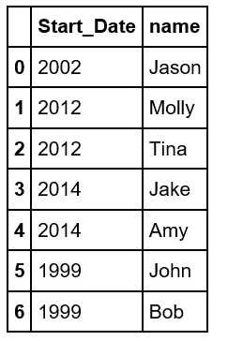
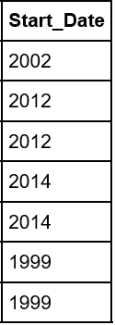
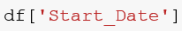
Unique - Example
Select the column you would like the unique values for

Slide 38
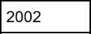
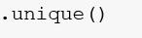
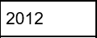
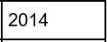
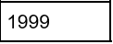
Unique Example (Cont’d)

Slide 39
Groupby
With “groupby”, you
split the data into groups based on some criteria
apply a function to each group independently
combine the results into a data structure
A
A
A
A
B
B
C
B
B
C
C
C

Slide 40
Groupby - Example
City | Country | Rain Fall (inch)
Baghdad | Iraq | 2.24
Beijing | China | 25
New York | USA | 47.2
Hong Kong | China | 87
Los Angeles | USA | 15
Karbala | Iraq | 3.5
Chicago | USA | 34
Seattle | USA | 40

Slide 41
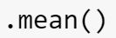
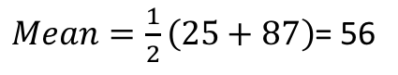
Groupby - Example (Cont’d)
City | Country | Rain Fall (inch)
Baghdad | Iraq | 2.24
Beijing | China | 25
New York | USA | 47.2
Hong Kong | China | 87
Los Angeles | USA | 15
Karbala | Iraq | 3.5
Chicago | USA | 34
Seattle | USA | 40
Country | Mean Rain Fall
China | 56
$Mean=\frac{1}{2}\left(25+87\right)$= 56

Slide 42
Groupby - Example (Cont’d)
City | Country | Rain Fall (inch)
Baghdad | Iraq | 2.24
Beijing | China | 25
New York | USA | 47.2
Hong Kong | China | 87
Los Angeles | USA | 15
Karbala | Iraq | 3.5
Chicago | USA | 34
Seattle | USA | 40
Country | Mean Rain Fall
China | 56
Iraq | 2.87
USA | 34.5

Slide 43
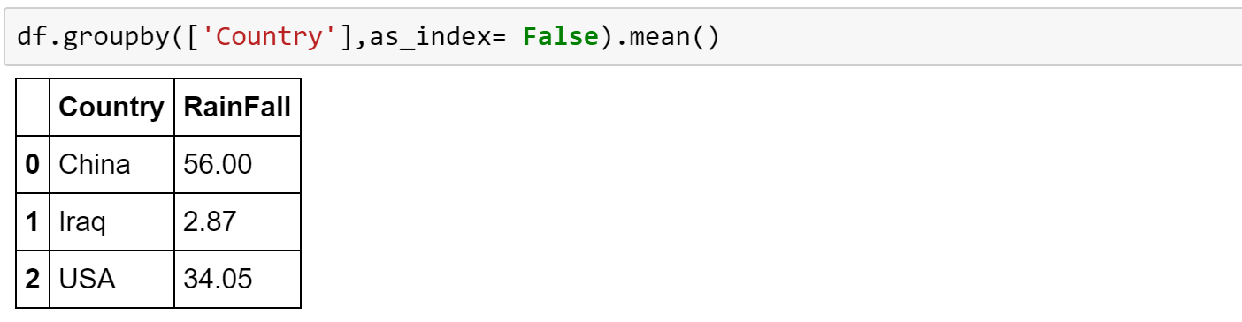
Groupby - Example (Cont’d)

Slide 44
Merge
Merging method involves merging two dataframes together based on a common column
A | B | C
1
2
3
D | E
A | D | E
1
2
3
A | B | C | D | E
1
2
3

Slide 45
Merge - Example
We have two Dataframes:
Student ID numbers, first and last Names
Student ID and there Grades for English and Math
We would like to create a new dataframe that contains the student ID number, first name, last name and grades for math and English

Slide 46
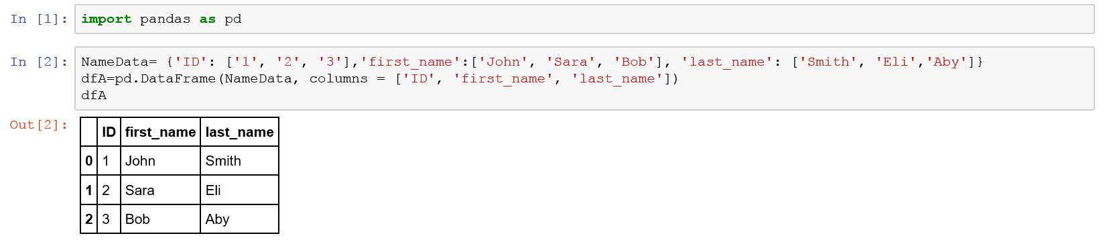
Merge – Example (Cont’d)

Slide 47
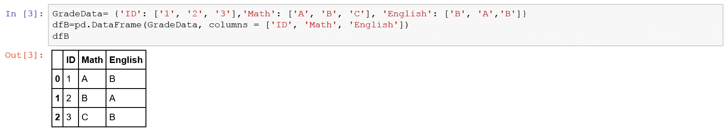
Merge - Example (Cont’d)

Slide 48
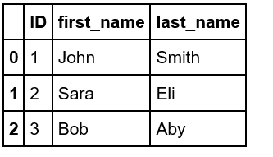
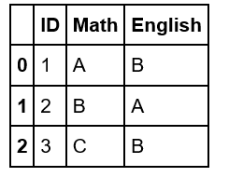
Merge – Example (Cont’d)
Let’s merge the two dataframes on the “ID” column

Slide 49
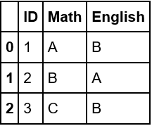
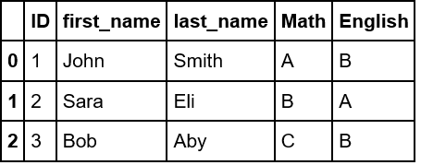
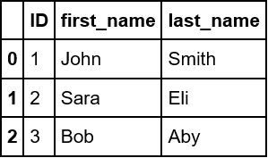
Merge – Example (Cont’d)

Slide 50
Data Cleaning – Dropping Data
Dropping Rows

Slide 51
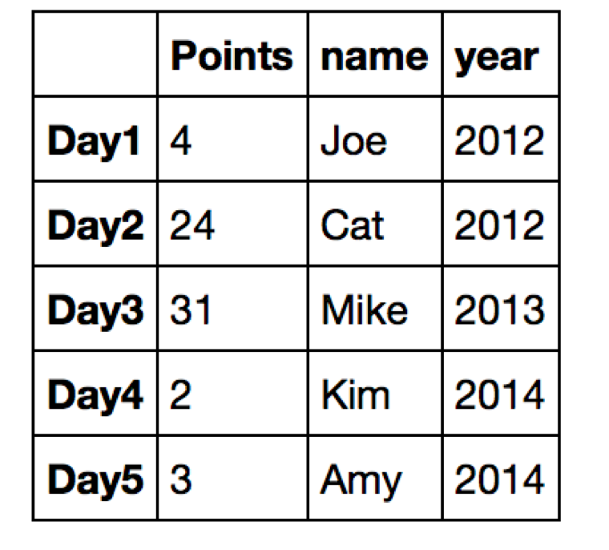
Data Cleaning – Dropping Rows
Dropping Rows

Slide 52
Data Cleaning – Dropping Columns
Dropping Columns

Slide 53
Data Cleaning – Dropping Columns
Dropping Columns

Slide 54
Data Cleaning – Missing Values
How to deal with missing data?
Drop data
drop the variable
drop the data entry
Replace data
replace it by mean
replace it by frequency
replace it based on other functions

Slide 55
Data Cleaning – Missing Data (Cont’d)

Slide 56
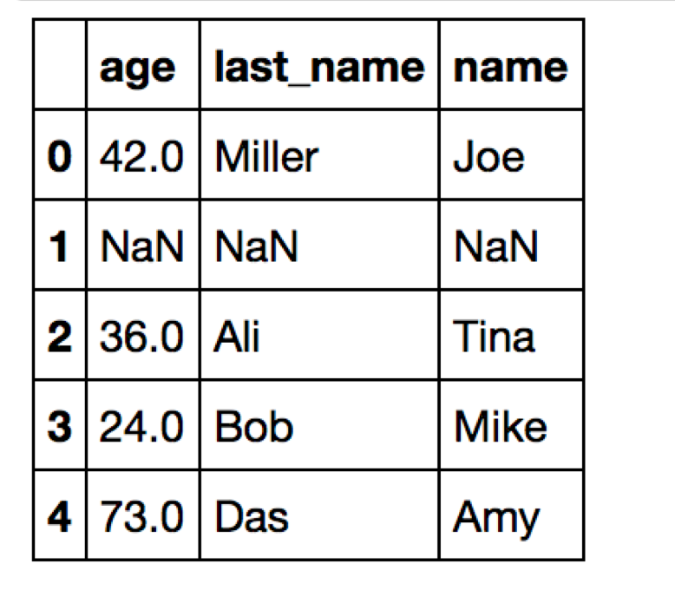
Data Cleaning – Missing Data (Cont’d)

Slide 57
Data Cleaning – Missing Values (Cont’d)
Replace Data
First, calculate the new value that would be used in replacement.
avg = df["normalized-losses"].astype("int").mean(axis = 0)
normalized-losses | make
... | ...
164 | audi
164 | audi
NaN | audi
158 | audi
... | ...
avg=122

Slide 58
Data Cleaning – Missing Values (Cont’d)
Replace Data
Then, use dataframe.replace(missing value, new value) method, replace (missing value) by (new value)
df["normalized-losses"].replace(np.nan, avg, inplace = True)
normalized-losses | make
... | ...
164 | audi
164 | audi
NaN | audi
158 | audi
... | ...
normalized-losses | make
... | ...
164 | audi
164 | audi
122 | audi
158 | audi
... | ...

Slide 59
Data Cleaning – Data Normalization
Normalization utilization?
Not-normalized:
Values of “income” is about 1000 times than “age”
“age” [0-100] and “income” [20000, 500000] are in different range.
Hard to compare “age” and “income”.
When we do further analysis (regression for example), “income” will influence the result more, compared to “age”, due to its larger range scale.
age | income
20 | 100000
30 | 20000
40 | 500000
Before
Normalized:
Similar value range.
Both variables have similar intrinsic influence on analytical model.
age | income
0.5 | 0.2
0.75 | 0.04
1 | 1
After

Slide 60
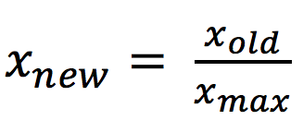
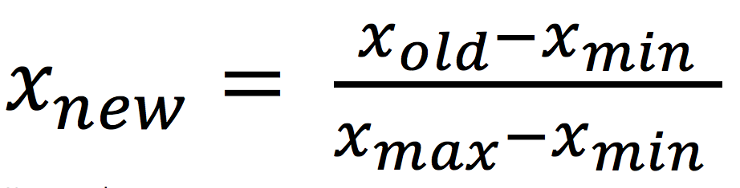
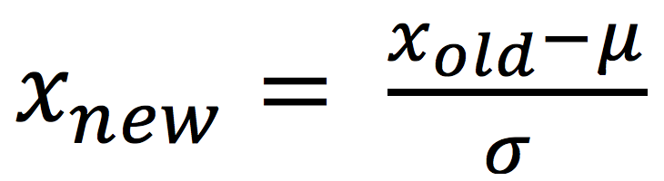
Data Cleaning – Data Normalization
Implementation:
Normalize column “length” into the range of [0,1]
Several ways of normalization
here we use ① and lambda x: x/x.max()method
①
②
③
df[["length"]] = df[["length"]]/df[["length"]].max()
length | width | height
168.8 | 64.1 | 48.8
168.8 | 64.1 | 48.8
171.2 | 65.5 | 52.4
... | ... | ...
length | width | height
0.811148 | 64.1 | 48.8
0.811148 | 64.1 | 48.8
0.822681 | 65.5 | 52.4
... | ... | ...

Slide 61
Summary
Describe the data – can be done all together in df.describe
df.mean, df.count, df.std, df.min, df.max
Unique Values – df[‘column’].unique
Group Values by a field or value – df.groupby([‘Column’],asindex=False)
Merge Data – using key fields – pd.merge(df1,df2,on=‘ID’)
Data Cleaning – Dropping data
Drop Row df.drop([‘index1’,’index2’])
Drop Columns df.drop(‘column_name’, axis=1)
Data Cleaning – Missing values
Remove missing values – df.dropna
Or replace data with new value e.g. variance, mean or function – df.replace
Data Normalization – Setting all values between 0 and 1
Prevents a feature larger scale biasing results

